Slide 1


Slide 2


Bee Plugin Email Editor Integration with CRM
Greg Harmelink
Associate Director of Advancement Services

Slide 3


Background
Recent History of Email Solicitation
at The University of Georgia

Slide 4

UGA and CRM
Central Development/College Development
Number of CRM Sites: 50+
Went live with CRM: July, 2013
Constituents: ~675,000
CRM users: 700+
E-mails sent per year: ~1,500

Slide 5





Pre-Blackbaud CRM
Variety of Services
Kintera Sphere
Harris Connect
Outlook / BCC
Steltor
MailChimp
Constant Contact
Variety of E-mail Design
In-house one-off design
CMS driven templates
Contract work
Outlook

Slide 6
Historical E-Mail Issues
50+ people creating content with little direction
Incomplete management of e-mail preferences
No centralized database of constituent e-mail contact across campus
Inconsistent and poor e-mail design
Required text in solicitations excluded
Lengthy design/development process
Not designed for mobile
E-mail efforts were a burden on web servers hosting assets

Slide 7
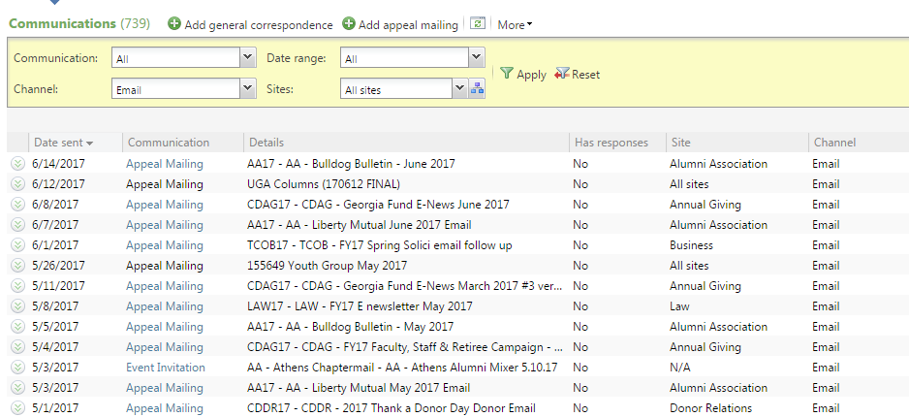
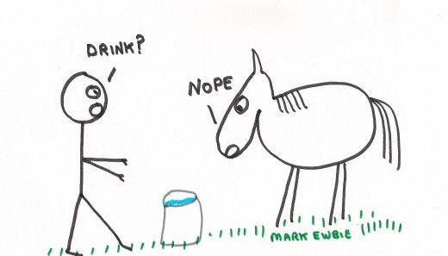
Goals
Provide a single managed process for communications
Minimize time to send an e-mail
Improve quality of e-mail communication
Minimize impact of e-mail on e-commerce systems
Get staff to actually use the system

Slide 8

Initial E-mail Processes in CRM
Utilized CMS (ExpressionEngine) to create html e-mail code
Manual process
Centrally designed by web development team
1 – 20 day turnaround
E-mail manually copied to static e-mail server
E-mail source copied to new CRM e-mail
E-mail package created
DME / Event Invitation steps
E-mails tested with test Marketing Efforts / Events
Provided centralized system

Slide 9

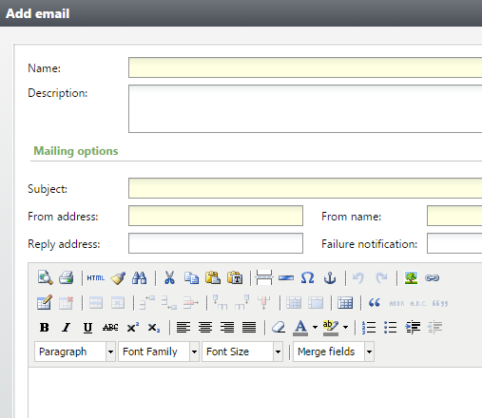

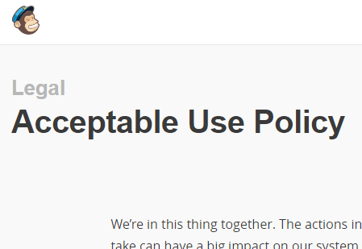
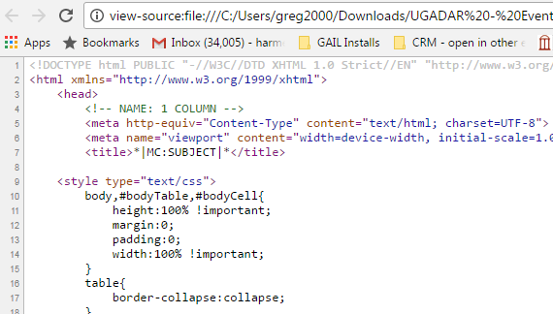
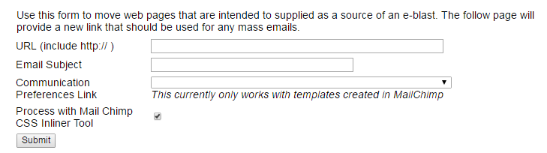
Second Attempt
Lost designer who worked on HTML e-mails
Request to replicate MailChimp template
MailChimp encouraged for design
Created tool designed to transform MC
E-mail source copied to new GAIL e-mail
E-mail package created
DME / Event Invitation steps
Provided centralized system
Comfortable UI that people liked
Too many steps
CRM WYSIWYG issues
MC Usage Policy

Slide 10
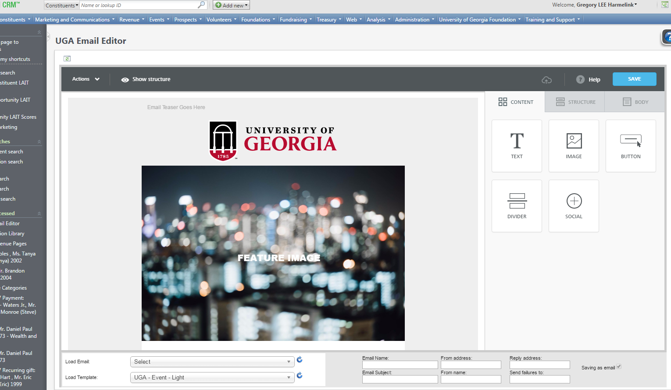
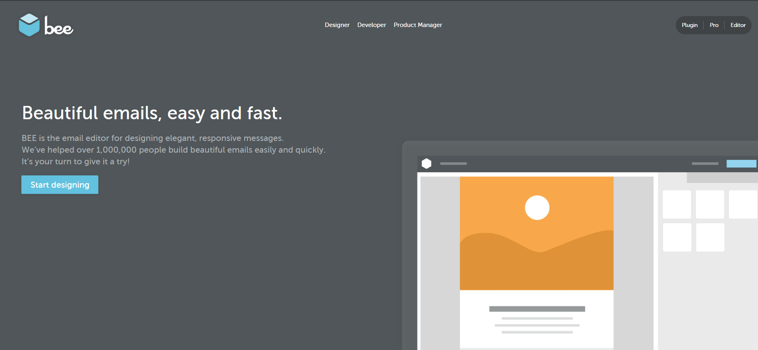
Third Attempt - BEE
What is the Bee Plugin?
Product offered by MailUp for managing HTML e-mail design
Designed to be integrated
Intuitive UI
Two Outputs
JSON configuration file
Rendered HTML
http://beefree.io

Slide 11
Assumptions
Focus on DME and Invitations
BBIS out of scope
Single Supported Export Definition
Initial deployment without merge fields
Limited development time

Slide 12
Architecture

Slide 13



Integration / Architecture
Manage e-mail design
Image management
iframe
Bee Plugin
Hosts “View in Browser” links and assets for e-mails
CRM User
LAMP Environment
Static Web Server
Management of Bee JSON configurations
Writes to Static Web Server
Calls custom CRM web services
Process custom Dataform to update the EmailTemplate table
All other OOB
CRM

Slide 14
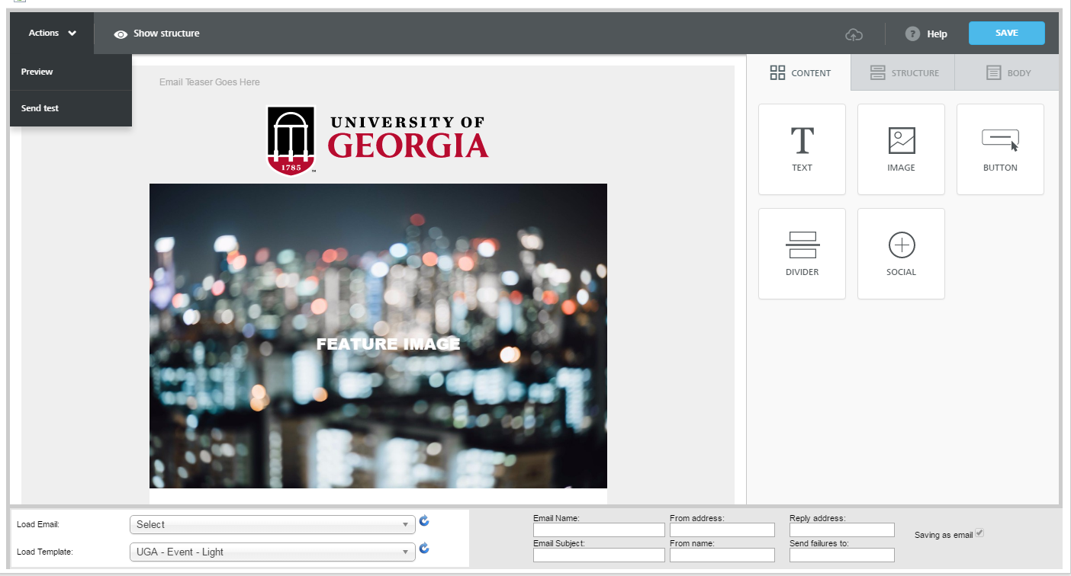
Integration with CRM
Required for BEE configurations
Required for CRM e-mails

Slide 15
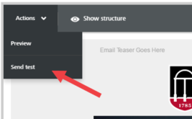
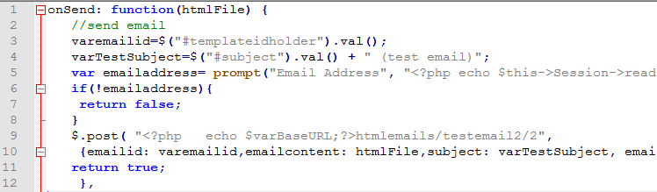
Bee Configuration: onSend
Calls a PHP web service
Sends a test e-mail to comma-separated list

Slide 16
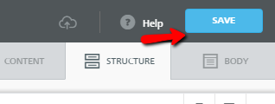
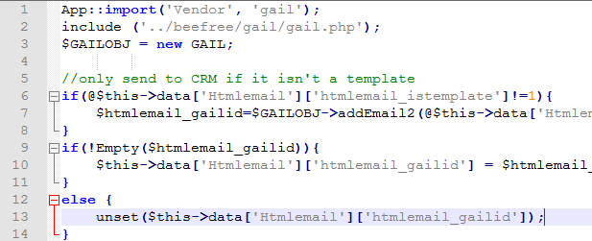
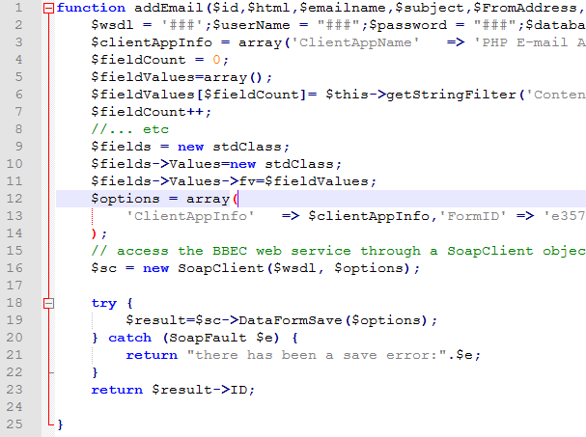
Bee Configuration: onSave
Pre-Save validation
Subject / Required Addresses
HTML Tidy / Wrap
Moves files to Static Server
Alters all references to images
Calls PHP web service
Name Uniqueness
Communication Preferences
Privacy Policy
PHP web service calls CRM web service
Name Uniqueness
CRM save error
Updates e-mail record in LAMP environment with CRM GUID

Slide 17
BEE Plugin Integration
Usage Demonstration

Slide 18
Benefits
Encourages use of CRM for e-mail
More central place to review e-mails being sent out
Encourages consistency
Bee HTML source code changes as best practices change
Reduces steps and saves time
Better management of communication preferences
Removes dependency on web design staff
Well designed responsive e-mails
Content editor can technically work from outside of CRM

Slide 19
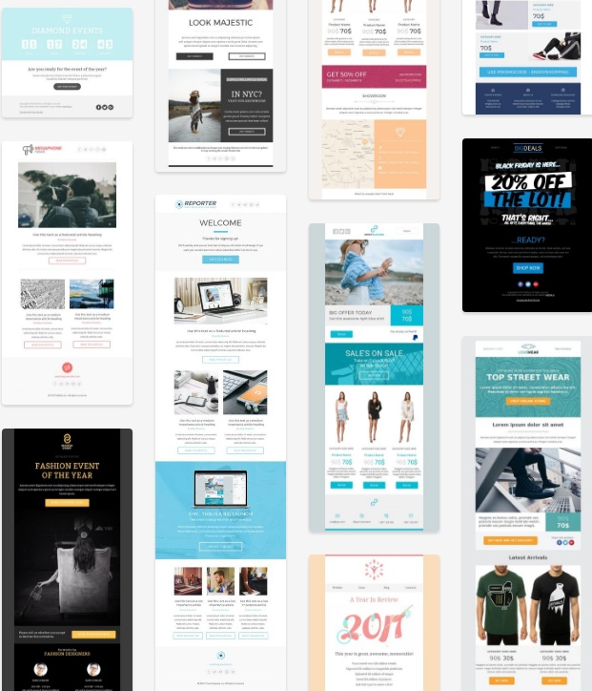
Benefits continued…
Reduces time needed for testing
Ability to test templates from within CRM
Restrict ability to manage base templates
Eliminates corrupted code CRM WYSIWYG
Minimal coding required

Slide 20

Possible Future Enhancements
Merge Fields
Better UI for notifications (not alerts)
Auto create E-mail Package
Support for BBIS
Integration with UGA Image Bank

Slide 21
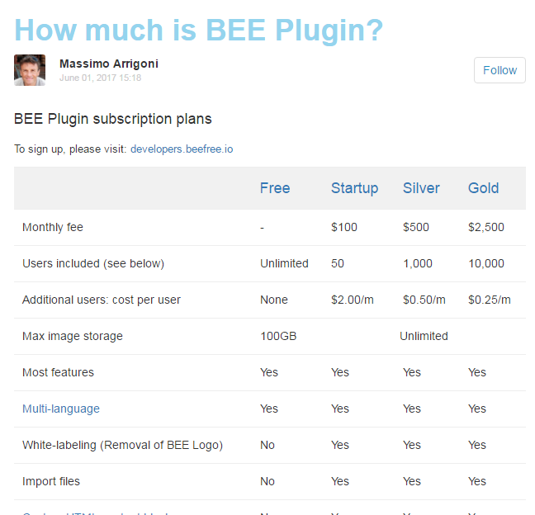
Costs
Started with a 50 user license
$100/month (additional users $2/month)
Unlimited image storage
Support
Only counts actual users per month
Free Option
Unlimited users
100 GB image storage
BeeFree.io Cost Sheet

Slide 22


Questions?
Thank you!
Greg Harmelink – greg2000@uga.edu

